Slide 1
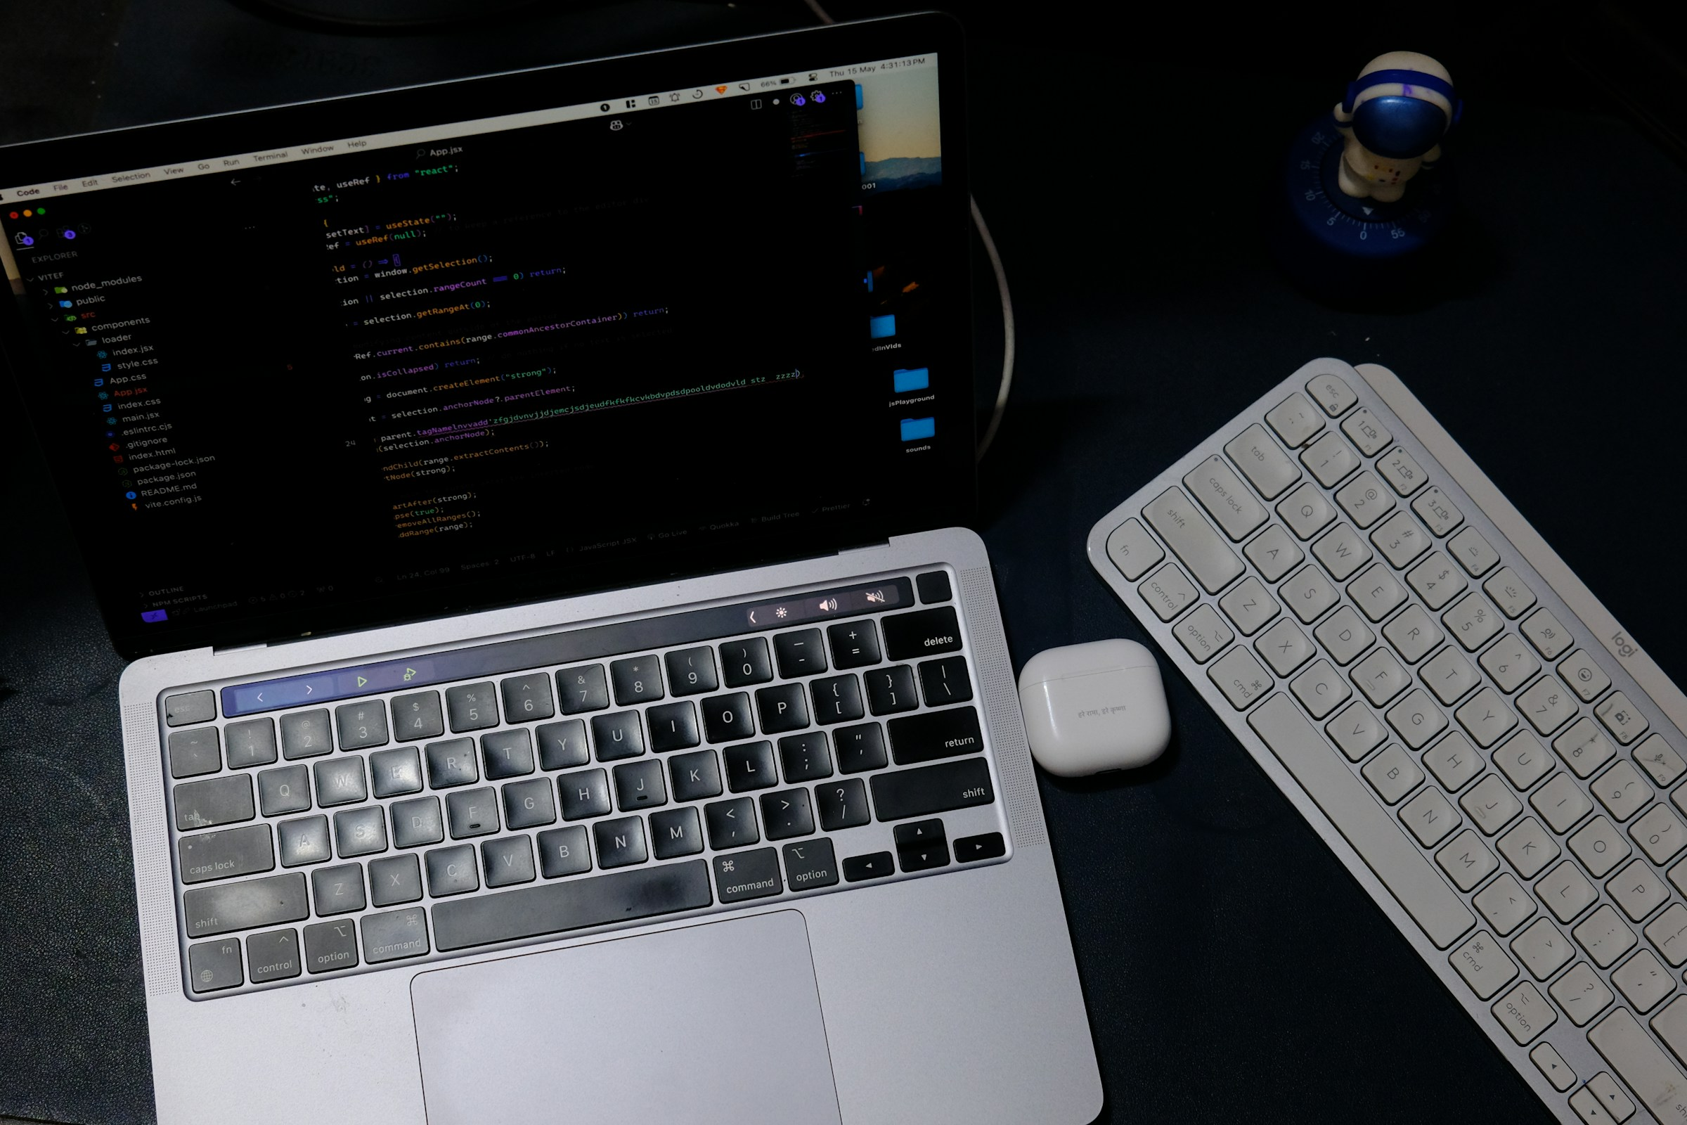
A 10-MINUTE ARGUMENT
WILL AI BE
COMPLETELY FREE?
(SOON)
Local models, open weights, and the costs that remain
THE SHORT ANSWER: ALMOST.
Notes:
When people say AI will become free, they usually mean the price of asking a model a question will approach zero. Local language models make that believable: download the weights, run them on your own machine, and stop paying for every token. But completely free is a much bigger claim. I will separate the visible price from the costs of owning, powering, maintaining, and governing AI.
[Sources]
- Stock photo: Rahul Mishra, Unsplash — https://unsplash.com/photos/laptop-and-keyboard-on-a-dark-desk-BA2ELfOTqJ4

Slide 2
LOCAL LLMS
02
Why the word ‘free’ is back
01
WEIGHTS TRAVEL
More capable models can be downloaded instead of accessed only through an API.
02
RUNTIMES MATURED
Ollama, llama.cpp, and MLX make local inference feel like ordinary software.
03
CHIPS CAUGHT UP
Modern laptops combine fast memory, GPUs, and NPUs in one consumer device.
The meter can disappear—even when the cost does not.
Notes:
Three changes brought the word free back. Capable model weights can now travel, runtimes make them feel like normal apps, and consumer chips are finally strong enough for useful local inference. Together, these changes can remove the token meter. That is a real shift, even though the machine, electricity, maintenance, and responsibility still exist.
[Sources]
- Ollama documentation — https://docs.ollama.com/
- llama.cpp README — https://github.com/ggml-org/llama.cpp
- Apple MLX organization — https://github.com/ml-explore

Slide 3
LOCAL LLMS
03
What makes an LLM local?
YOUR DEVICE
INFERENCE
PROMPT
→
→
ANSWER
LAPTOP
DESKTOP
PHONE
PRIVATE SERVER
THE MODEL RUNS HERE
THE IMPORTANT DETAIL
THE ORDINARY PROMPT → ANSWER PATH
DOES NOT REQUIRE RENTING A REMOTE MODEL.
hardware you control
Updates and optional tools may still use the internet.
Notes:
A local LLM is a language model whose main inference happens on hardware you control. The key idea is not that the model is tiny or offline forever. It is that the ordinary path from prompt to answer does not require renting a remote model. Updates and optional tools may still use the internet.
[Sources]
- Ollama documentation — https://docs.ollama.com/

Slide 4
LOCAL LLMS
04
“Free” has four different meanings
$0
OPEN
LOCAL
∞
PRICE
RIGHTS
LOCATION
USAGE
No charge at the moment of use.
Can you inspect, modify, and redistribute it?
Do prompts and files stay on your machine?
Can you run it repeatedly without a token bill?
One word. Four promises. Local AI only guarantees some of them.
Notes:
Free has four meanings. It can mean zero price, broad legal rights, local processing, or unlimited use. Those promises overlap but are not identical. A free download can have a restrictive license. A local model can still call cloud plugins. Unlimited use still consumes power. So the useful question is always: free in which sense?
[Sources]
- Open Source AI Definition 1.0 — https://opensource.org/ai/open-source-ai-definition

Slide 5
LOCAL LLMS
05
A local model is a four-layer stack
01
02
03
04
MODEL WEIGHTS
RUNTIME
HARDWARE
APP + DATA
+
+
+
The learned parameters
Loads, quantizes, and serves the model
RAM / VRAM, bandwidth, CPU / GPU / NPU
The interface, files, tools, logs, and permissions
If any layer is weak, the experience is weak.
Notes:
A downloadable model is only the first layer. You also need a runtime, hardware with enough memory and bandwidth, and an application that manages files, tools, logs, and permissions. Much of the product value and many of the risks sit outside the weights. If one layer is weak, the whole experience is weak.
[Sources]
- Ollama model import documentation — https://docs.ollama.com/import
- llama.cpp server documentation — https://github.com/ggml-org/llama.cpp/blob/master/tools/server/README.md

Slide 6



LOCAL LLMS
06
Two levels: model families and runtimes
MODEL FAMILIES
LOCAL RUNTIMES
llama.cpp
MLX
QWEN
KIMI
OLLAMA
Weights define what the model can do.
Runtimes make the weights usable.
OPEN WEIGHTS ARE SUPPLY. RUNTIMES TURN THEM INTO A PRODUCT.
Notes:
Model families such as Qwen and Kimi provide the intelligence: the architecture, weights, and capabilities. Their releases are increasingly capable, but a model file is still supply rather than a finished consumer product. Different sizes and licenses target different machines and uses, so the biggest model is not automatically the best choice.
[Sources]
- Qwen official GitHub — https://github.com/QwenLM
- Moonshot AI official GitHub — https://github.com/MoonshotAI
- Ollama — https://docs.ollama.com/
- llama.cpp — https://github.com/ggml-org/llama.cpp
- Apple MLX — https://github.com/ml-explore

Slide 7
LOCAL LLMS
07
The runtime turns weights into a product
01
02
03
04
LOAD
COMPRESS
ACCELERATE
SERVE
→
→
→
Read model files
Choose precision
Use CPU / GPU / NPU
Expose an app interface
OLLAMA · LLAMA.CPP · MLX
The same weights can feel very different in a different runtime.
Notes:
Runtimes such as Ollama, llama.cpp, and MLX turn weights into usable software. They handle model formats, quantization, hardware acceleration, and an interface that apps can call. This layer is why local AI has become much easier. The runtime often determines whether the model feels fast, stable, and ordinary to use.
[Sources]
- Ollama — https://docs.ollama.com/
- llama.cpp — https://github.com/ggml-org/llama.cpp
- Apple MLX — https://github.com/ml-explore

Slide 8
LOCAL LLMS
08
The first reality check: memory
4-BIT WEIGHTS — APPROXIMATE BASE FOOTPRINT
FORMULA
8B
~4 GB
PARAMS
× BITS
÷ 8
32B
~16 GB
70B
~35 GB
+ runtime
+ context cache
+ operating system
A 16 GB machine does not have 16 GB available to the model.
Notes:
Memory is the first hard limit. At four-bit precision, eight billion parameters need roughly four gigabytes just for weights; thirty-two billion need about sixteen; seventy billion need about thirty-five. Then add the runtime, context cache, operating system, and other apps. A sixteen-gigabyte laptop does not have sixteen gigabytes available to the model.
[Sources]
- llama.cpp quantization documentation — https://github.com/ggml-org/llama.cpp/blob/master/tools/quantize/README.md

Slide 9
LOCAL LLMS
09
Quantization is the local-AI bargain
FULLER PRECISION
QUANTIZED
THE TRADE
MORE BITS
FEWER BITS
↓ SIZE
↑ SPEED
? QUALITY
larger memory footprint
slower on modest hardware
→
smaller memory footprint
faster and more portable
16 · 8 · 6
4 · 3 · 2
The right setting is task-specific.
Compression makes local possible; evaluation tells you whether it is still good enough.
Notes:
Quantization is the bargain that makes local AI practical. It stores model weights with fewer bits, reducing memory and often improving speed. The trade-off is that aggressive compression can weaken quality. The useful question is not whether a model is quantized, but whether that specific size and precision still clear the quality bar for the task.
[Sources]
- llama.cpp quantization documentation — https://github.com/ggml-org/llama.cpp/blob/master/tools/quantize/README.md

Slide 10
LOCAL LLMS
10
Fitting is not the same as running well
01
02
THE EXPERIENCE TEST
CAPACITY
BANDWIDTH
CAN IT RUN?
Does the model fit?
RAM / VRAM
How quickly can weights move?
tokens / second
is only question one.
IS IT FAST, QUIET, STABLE, AND WORTH THE POWER?
03
04
THERMALS
BATTERY
Can speed be sustained?
heat / fans
Can you afford the energy?
mobile runtime
The best local model is often smaller than the biggest model that technically fits.
Notes:
Fitting is not the same as running well. Capacity answers whether the model loads. Bandwidth affects tokens per second. Thermals decide whether speed lasts, and battery decides whether mobile use is sensible. A smaller model that responds instantly and stays quiet can create a better experience than a larger model that only technically fits.
[Sources]
- llama.cpp README, supported hardware and quantization — https://github.com/ggml-org/llama.cpp

Slide 11
LOCAL LLMS
11
Where local AI already wins
01
02
PRIVATE DRAFTS
OFFLINE WORK
Sensitive text can stay close to the user.
Once installed, the core model needs no connection.
03
04
LOW-LATENCY LOOPS
HIGH-VOLUME ROUTINES
Autocomplete and agents benefit from instant repeated calls.
No per-request bill for narrow, repeated workloads.
LOCAL WINS WHEN THE TASK IS REPEATED, PRIVATE, OR DISCONNECTED.
Notes:
Local AI already wins for private drafts and offline work. Sensitive notes can stay close to the user, and the core model can keep working on a flight or in a classroom with poor connectivity. These are not benchmark victories. They are product advantages created by location, control, and availability.
[Sources]
- Ollama documentation — https://docs.ollama.com/
- Apple MLX-LM — https://github.com/ml-explore/mlx-lm

Slide 12
LOCAL LLMS
12
The sweet spot: fast, repeated loops
01
AUTOCOMPLETE
02
CLASSIFICATION
↻
↻
dozens of tiny calls
the same narrow decision
03
DRAFT CLEANUP
04
LOCAL AGENTS
↻
↻
private text, many passes
short tool loops
REPEATED + PREDICTABLE + PRIVATE = LOCAL ADVANTAGE
Notes:
Local also wins in fast, repeated loops. Autocomplete, classification, transcription cleanup, and narrow agents benefit from low latency and no per-request bill. The pattern is clear: local is strongest when the task is frequent, predictable, private, or disconnected. It is less compelling when each request is rare and exceptionally difficult.
[Sources]
- Apple MLX-LM — https://github.com/ml-explore/mlx-lm

Slide 13
LOCAL LLMS
13
Where the cloud still wins
01
02
03
FRONTIER QUALITY
ELASTIC SCALE
FRESHNESS + TOOLS
The hardest reasoning, coding, and multimodal tasks.
Large bursts without buying idle hardware in advance.
Current information, managed search, and maintained integrations.
HARD
BURST
CURRENT
OWN THE ROUTINE.
RENT THE EXCEPTIONAL.
Cloud is expensive when constant; local is expensive when idle.
Notes:
Cloud services still win for frontier quality, elastic scale, and fresh information with managed tools. They hide operational complexity and can serve large bursts without buying idle hardware. The rule is not local good and cloud bad. A better rule is: own the routine, and rent the exceptional.
[Sources]
- Ollama documentation notes cloud models for larger workloads — https://docs.ollama.com/

Slide 14
LOCAL LLMS
14
The economics are fixed cost vs. variable cost
LOCAL
ILLUSTRATIVE COST CURVES
HARDWARE
+ POWER
+ OPERATIONS
CLOUD
TOTAL COST
break-even depends
on utilization
LOCAL
High upfront cost
Low marginal request cost
USAGE →
If hardware sits idle, local can be more expensive—not less.
Notes:
Local converts variable cost into fixed cost. You buy hardware, pay for power, and take on operations; after that, each extra request can be cheap. Cloud does the opposite: little upfront investment, but a bill that rises with usage. The break-even point depends mainly on how often the hardware is actually used.

Slide 15
LOCAL LLMS
15
When does local actually pay off?
✓
STEADY VOLUME
Will the machine stay busy?
DECISION RULE
3–4 YES
✓
MODEL FIT
Can a modest model clear the bar?
local is worth testing
✓
PRIVACY VALUE
Is local control worth real money?
0–2 YES
cloud probably wins
✓
OPS CAPACITY
Can someone maintain the stack?
Free is a workload pattern, not a universal price.
Notes:
Before buying hardware, ask four questions: is the workload steady, is the model small enough, is privacy valuable, and can someone maintain it? Local economics improve when most answers are yes. If demand is occasional, quality requirements are extreme, or support capacity is missing, cloud may remain cheaper despite its token price.

Slide 16
LOCAL LLMS
16
Free weights can create a paid operations job
THE MODEL FILE IS NOT THE SERVICE.
Someone still owns reliability.
05
SUPPORT
04
Users + failures
SECURE
03
Access + supply chain
EVALUATE
02
Quality + regressions
UPDATE
01
Models + runtimes
DEPLOY
Install + configure
The cheaper the inference gets, the more visible the surrounding work becomes.
Notes:
A free model file can create a paid operations job. Someone must deploy it, update the runtime, test new versions, secure access, and support failures. In a hobby project that labor is hidden because the user performs it. In a company it becomes salary, time, and risk. The model file is not the service.
[Sources]
- llama.cpp server documentation — https://github.com/ggml-org/llama.cpp/blob/master/tools/server/README.md

Slide 17
LOCAL LLMS
17
What local privacy can protect
01
02
03
04
PROMPT
→
FILES
→
EMBEDDINGS
→
OUTPUT
what you ask
what you attach
what gets indexed
what the model writes
WHEN THE ENTIRE PATH IS LOCAL, THE PROVIDER DOES NOT SEE EVERY REQUEST.
Location reduces exposure; policy determines whether the route stays local.
Notes:
Local inference can keep prompts, files, embeddings, and outputs on the device. That reduces one important exposure: a model provider seeing every request. It is especially valuable for drafts, internal search, and personal data. But the protection only holds when the entire route from input to output actually stays local.
[Sources]
- Ollama documentation — https://docs.ollama.com/

Slide 18
LOCAL LLMS
18
Privacy has an asterisk
CAN STAY LOCAL
COMMON LEAK POINTS
PROMPTS
FILES
EMBEDDINGS
OUTPUTS
*
PLUGINS + TOOLS
*
TELEMETRY
→
*
LOGS + BACKUPS
*
MODEL DOWNLOADS
when the entire path is local
Local inference improves privacy; it does not automatically secure the workflow.
Notes:
Privacy therefore has an asterisk. Plugins may call external services, telemetry may transmit usage, logs and backups may copy sensitive content, and downloads expand the supply chain. Local is a strong architectural advantage, not an automatic guarantee. Privacy comes from the whole workflow and its policy, not from one setting.
[Sources]
- llama.cpp server documentation, tool and file access — https://github.com/ggml-org/llama.cpp/blob/master/tools/server/README.md

Slide 19
LOCAL LLMS
19
Open weights are not automatically open source
✓
?
?
?
DOWNLOAD
MODIFY
COMMERCIAL
REPRODUCE
Can you obtain the parameters?
Can you fine-tune and redistribute?
Can a business use the model?
Do you have training data + code?
OFTEN
VARIES
CHECK
RARE
Read the model card and license before building a product.
Notes:
Downloadable is not automatically open source. Rights to modify, redistribute, or use a model commercially vary by license, and full reproducibility may require training code and meaningful data information. A hobbyist may ask only whether a model runs. A company must also read the model card, license, and use restrictions.
[Sources]
- Open Source AI Definition 1.0 — https://opensource.org/ai/open-source-ai-definition
- Example of model-specific licensing in Qwen documentation — https://github.com/QwenLM/Qwen

Slide 20
LOCAL LLMS
20
The bad side: access spreads risk too
01
02
MISUSE AT SCALE
SHADOW AI
Cheap private generation lowers the cost of spam, scams, and harmful automation.
Employees may run unapproved models on sensitive company data.
03
04
SUPPLY CHAIN
ACCOUNTABILITY GAP
Model files, runtimes, and plugins become another path for malicious code.
When a local system causes harm, responsibility can be harder to trace.
Democratizing capability also democratizes responsibility.
Notes:
Cheaper private generation lowers the cost of spam, scams, and harmful automation. Inside organizations it can also create shadow AI, where employees run unapproved models on sensitive data. Wider access is valuable, but it spreads responsibility to users and small teams that may not have mature safety or governance practices.

Slide 21
LOCAL LLMS
21
The risks that hide below the interface
01
02
03
SUPPLY CHAIN
REBOUND EFFECT
ACCOUNTABILITY
Models, runtimes, and plugins can all carry compromised code or unexpected behavior.
Cheaper inference can increase total use, so efficiency does not guarantee less energy.
Decentralized systems make responsibility and incident tracing harder to centralize.
Lower cost moves risk outward—from providers to devices, teams, and users.
Notes:
The remaining risks are less visible. Model files, runtimes, and plugins expand the software supply chain. More efficient inference can also increase total use, so lower cost does not guarantee lower energy consumption. And when decentralized systems cause harm, responsibility can be harder to trace than with one managed provider.

Slide 22
FORECAST
22
Three things I expect by 2030
01
02
03
SMALL GETS SURPRISING
LOCAL BECOMES A FEATURE
CLOUD STAYS PREMIUM
Better training and compression make modest models useful for more daily work.
Operating systems and apps route routine tasks to on-device models by default.
The freshest, hardest, and largest jobs continue to justify remote compute.
This is a forecast, not a certainty: hardware, regulation, and model progress can change the path.
Notes:
By 2030, I expect small models to become surprisingly capable, local AI to disappear into operating systems and apps, and cloud AI to remain premium infrastructure for the hardest and freshest jobs. This is a forecast, not a certainty. Hardware economics, regulation, and model progress can still change the pace.
[Sources]
- Inference efficiency background: llama.cpp quantization documentation — https://github.com/ggml-org/llama.cpp/blob/master/tools/quantize/README.md
- Apple MLX — https://github.com/ml-explore

Slide 23
FORECAST
23
The likely future is a hybrid router
LOCAL DEFAULT
CLOUD ESCALATION
ROUTINE
PRIVATE
OFFLINE
LOW-LATENCY
ROUTER
HARDEST
FRESHEST
LARGEST
COLLABORATIVE
SMALLEST
MODEL THAT
CLEARS THE
QUALITY BAR
←
→
The user may stop caring where the answer ran—as long as the policy is clear.
Notes:
The likely architecture is hybrid. A router chooses the smallest model that clears the quality bar. Routine, private, offline, and low-latency work stays on the device; hard, fresh, large, or collaborative work escalates to the cloud. Users should be able to see and control when their data leaves the machine.

Slide 24
THE VERDICT
24
SO, WILL AI
BE FREE?
MAY FEEL FREE
ROUTINE CALLS
ON OWNED HARDWARE
WITHOUT A TOKEN METER
ALMOST.
WILL NEVER BE FREE
BUILDING
POWERING
MAINTAINING
SECURING
GOVERNING
AI BECOMES A UTILITY—NOT ZERO-COST MAGIC.
Notes:
So, will AI be completely free? Almost, from the user's narrow point of view. Routine calls on hardware you already own may feel free because the token meter disappears. But AI will never be free to build, power, maintain, secure, and govern. It becomes a utility, not zero-cost magic—and the real shift is who owns the cost and control.

